Slide 1
Hidden Variables, the EM Algorithm, and Mixtures of Gaussians
03/16/17
Computer Vision
CS 543 / ECE 549
University of Illinois
Derek Hoiem

Slide 2
Today’s Class
Examples of Missing Data Problems
Detecting outliers (HW 4, problem 2)
Latent topic models
Segmentation (HW 4, problem 3)
Background
Maximum Likelihood Estimation
Probabilistic Inference
Dealing with “Hidden” Variables
EM algorithm, Mixture of Gaussians
Hard EM

Slide 3

Missing Data Problems: Outliers
You want to train an algorithm to predict whether a photograph is attractive. You collect annotations from Mechanical Turk. Some annotators try to give accurate ratings, but others answer randomly.
Challenge: Determine which people to trust and the average rating by accurate annotators.
Annotator Ratings
10
8
9
2
8
Photo: Jam343 (Flickr)

Slide 4
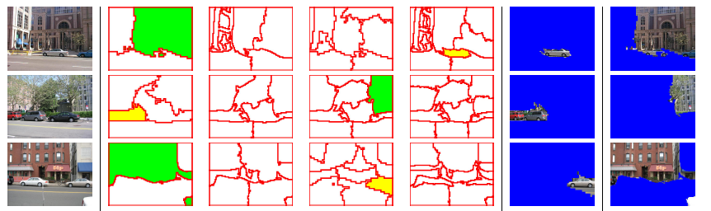
Missing Data Problems: Object Discovery
You have a collection of images and have extracted regions from them. Each is represented by a histogram of “visual words”.
Challenge: Discover frequently occurring object categories, without pre-trained appearance models.
http://www.robots.ox.ac.uk/~vgg/publications/papers/russell06.pdf

Slide 5

Missing Data Problems: Segmentation
You are given an image and want to assign foreground/background pixels.
Challenge: Segment the image into figure and ground without knowing what the foreground looks like in advance.
Foreground
Background

Slide 6
Missing Data Problems: Segmentation
Challenge: Segment the image into figure and ground without knowing what the foreground looks like in advance.
Three steps:
If we had labels, how could we model the appearance of foreground and background?
Once we have modeled the fg/bg appearance, how do we compute the likelihood that a pixel is foreground?
How can we get both labels and appearance models at once?
Background
Foreground

Slide 7
Maximum Likelihood Estimation
If we had labels, how could we model the appearance of foreground and background?
Background
Foreground

Slide 8
Maximum Likelihood Estimation
data
parameters

Slide 9
Maximum Likelihood Estimation
Gaussian Distribution
Notes:
Assume data is i.i.d., take log, and solve using partial derivatives.

Slide 10
Maximum Likelihood Estimation
Gaussian Distribution

Slide 11


Example: MLE
Parameters used to Generate
fg: mu=0.6, sigma=0.1
bg: mu=0.4, sigma=0.1
im
labels
>> mu_fg = mean(im(labels))
mu_fg = 0.6012
>> sigma_fg = sqrt(mean((im(labels)-mu_fg).^2))
sigma_fg = 0.1007
>> mu_bg = mean(im(~labels))
mu_bg = 0.4007
>> sigma_bg = sqrt(mean((im(~labels)-mu_bg).^2))
sigma_bg = 0.1007
>> pfg = mean(labels(:));

Slide 12
Probabilistic Inference
2. Once we have modeled the fg/bg appearance, how do we compute the likelihood that a pixel is foreground?
Background
Foreground

Slide 13
Probabilistic Inference
Compute the likelihood that a particular model generated a sample
component or label

Slide 14
Probabilistic Inference
Compute the likelihood that a particular model generated a sample
component or label

Slide 15
Probabilistic Inference
Compute the likelihood that a particular model generated a sample
component or label

Slide 16
Probabilistic Inference
Compute the likelihood that a particular model generated a sample
component or label

Slide 17

Example: Inference
Learned Parameters
fg: mu=0.6, sigma=0.1
bg: mu=0.4, sigma=0.1
im
>> pfg = 0.5;
>> px_fg = normpdf(im, mu_fg, sigma_fg);
>> px_bg = normpdf(im, mu_bg, sigma_bg);
>> pfg_x = px_fg*pfg ./ (px_fg*pfg + px_bg*(1-pfg));
p(fg | im)

Slide 18
Dealing with Hidden Variables
3. How can we get both labels and appearance parameters at once?
Background
Foreground

Slide 19
Mixture of Gaussians
mixture component
component model parameters
component prior

Slide 20
Mixture of Gaussians
With enough components, can represent any probability density function
Widely used as general purpose pdf estimator

Slide 21
Segmentation with Mixture of Gaussians
Pixels come from one of several Gaussian components
We don’t know which pixels come from which components
We don’t know the parameters for the components

Slide 22
Simple solution
Initialize parameters
Compute the probability of each hidden variable given the current parameters
Compute new parameters for each model, weighted by likelihood of hidden variables
Repeat 2-3 until convergence

Slide 23
Mixture of Gaussians: Simple Solution
Initialize parameters
Compute likelihood of hidden variables for current parameters
Estimate new parameters for each model, weighted by likelihood

Slide 24
Expectation Maximization (EM) Algorithm
Goal:
Log of sums is intractable
Jensen’s Inequality
for concave functions f(x)
(so we maximize the lower bound!)

Slide 25
Expectation Maximization (EM) Algorithm
Goal:
E-step: compute
M-step: solve
Notes:
The expectation is a lower bound on the marginal probability of x

Slide 26
Expectation Maximization (EM) Algorithm
log of expectation of P(x|z)
Goal:
E-step: compute
M-step: solve
expectation of log of P(x|z)
Notes:
The expectation is a lower bound on the marginal probability of x

Slide 27
EM for Mixture of Gaussians (by hand)
E-step:
M-step:

Slide 28
EM for Mixture of Gaussians (by hand)
E-step:
M-step:

Slide 29
EM Algorithm
Maximizes a lower bound on the data likelihood at each iteration
Each step increases the data likelihood
Converges to local maximum
Common tricks to derivation
Find terms that sum or integrate to 1
Lagrange multiplier to deal with constraints

Slide 30
EM Demos
Mixture of Gaussian demo
Simple segmentation demo

Slide 31
“Hard EM”
Same as EM except compute z* as most likely values for hidden variables
K-means is an example
Advantages
Simpler: can be applied when cannot derive EM
Sometimes works better if you want to make hard predictions at the end
But
Generally, pdf parameters are not as accurate as EM

Slide 32
Missing Data Problems: Outliers
You want to train an algorithm to predict whether a photograph is attractive. You collect annotations from Mechanical Turk. Some annotators try to give accurate ratings, but others answer randomly.
Challenge: Determine which people to trust and the average rating by accurate annotators.
Annotator Ratings
10
8
9
2
8
Photo: Jam343 (Flickr)

Slide 33
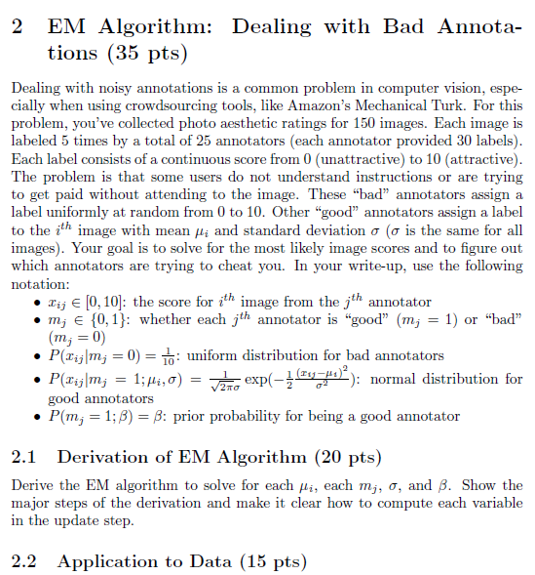
HW 4, problem 2
The false scores come from a uniform distribution
The true scores for each image have a Gaussian distribution
Annotators are always “bad” or always “good”
The “good/bad” label of each annotator is the missing data

Slide 34
Missing Data Problems: Object Discovery
You have a collection of images and have extracted regions from them. Each is represented by a histogram of “visual words”.
Challenge: Discover frequently occurring object categories, without pre-trained appearance models.
http://www.robots.ox.ac.uk/~vgg/publications/papers/russell06.pdf
Notes:
Model the appearance of each object as a histogram (probability of visual word). The missing data is which object each region belongs to.

Slide 35
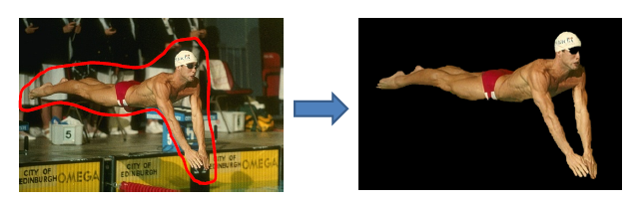
Next class
MRFs and Graph-cut Segmentation
Think about your final projects (if not done already)

